Slide 1
IRB New Investigator Training
Version: March 2021
Notes:
Revised- change title to “orientation objectives’

Slide 2
Overview
Human Subject Research Protections at Villanova
IRB structure at Villanova
Regulatory Background
IRB review process at Villanova
Post approval and closure of studies

Slide 3
Human Subject research protections at Villanova
Human subjects research at Villanova:
Follows federal regulations regardless of funding source.
Holds all human subjects research to the same standards.
Human Subject Protection Policies are:
Approved by the Institutional Official (IO) at the recommendation of the IRB.
Outlined in the Villanova HRPP Plan [HRPP Plan].

Slide 4
IRB at Villanova
The Villanova IRB:
Is chaired by an experienced researcher.
Has a focus and expertise on Social-Behavioral Research.
Has members from various departments with diverse expertise.
Has community members required per federal regulations.
Provides approvals in writing.
The IRB process at Villanova aligns with regulatory requirements, the HRPP Plan and is consistent with peers.
The Office of Research Protections (ORP) provides administrative support to the IRB. On behalf of the IRB, ORP receives all protocols and sends out all approvals.

Slide 5
Key information for investigators
All projects involving human subjects should be presented to the IRB to determine if the protocol meets the definition of research per federal regulations and requires review.
The IRB is the only regulatory committee authorized to approve your research study at Villanova.
Villanova University does not distinguish studies based on the source of funding.
Departmental approvals are required for conducting research.
The investigator handbook is the reference source for PIs. [Investigator Manual]

Slide 6
Regulatory background
The upcoming sections address:
Historical Background
Definition of Human Subject
Definition of Research
Qualifications of an Investigator

Slide 7
Historical background

Slide 8
Historical Background:
Basic Ethical Principles:
Respect for Persons
Beneficence
Justice

Slide 9
RESPECT FOR PERSONS
Treat individuals as autonomous agents.
Do not use people as means to an end.
Allow people to choose for themselves.
Give extra protection to those with limited autonomy.

Slide 10
BENEFICENCE
Acts of kindness or charity that go beyond duty.
Obligations derived from beneficence:
Do no harm
Prevent harm
Prevent evil
Promote good

Slide 11
Justice
Treat people fairly.
Fairly share burdens and benefits of research.
Distinguish procedural justice from distributive justice.

Slide 12
Human subjects research

Slide 13
Definition of Human subject
Human Subject, as it pertains to research in the HHS regulations, is defined in 46.102, Subpart A.
A living individual about whom an investigator conducting research obtains information or biospecimens through [intervention] or [interaction] with the individual, or [individually identifiable] [private information].

Slide 14
Definition of intervention
Intervention, as it pertains to research involving human subjects is defined in 46.102. It includes both:
physical procedures by which data are gathered (for example, venipuncture) and
manipulations of the subject or the subject’s environment that are performed for research purposes.
Notes:
Interventions include physical procedures through which data are gathered, such as (1) measuring brain function to supplement paper and pencil inquiries into the development of language, and (2) behavioral interventions such as experimental education programs or unproven psychosocial therapies. They also include manipulation of the subject or the subject's environment performed for research purposes, for example, studies investigating the effect of music on memory.

Slide 15
Definition of interaction
Interaction, as it pertains to research involving human subjects is defined in 46.102 and includes:
Any communication or interpersonal contact between an investigator and subject.
Notes:
Interactions include communication or interpersonal contact between the subject and the researcher. Communication does not have to be face to face, and may even exist entirely on paper or in electronic realms. Online surveys that do not ask for any identifying information about the subjects are considered interactions. Participant observation is a variant of interaction, often including both formal and informal interviews in addition to observation.

Slide 16
Definition of Identifiable information
Individually Identifiable information, as it pertains to research involving human subjects is defined in 46.102.
The identity of a subject is or may be readily ascertained by the investigator or readily associated with the information.
In addition, OHRP generally considers private information or specimens to be individually identifiable when they can be linked to specific individuals by the investigator(s) either directly or indirectly through coding systems.
This is according to NIH’s Guidance on Research Involving Coded Private Information or Biological Specimens

Slide 17
Definition of Private Information
Private Information, as it pertains to research involving human subjects is defined in 46.102 and includes:
information about behavior that occurs in a context in which an individual can reasonably expect that no observation or recording is taking place, and
information which has been provided for specific purposes by an individual and which the individual can reasonably expect will not be made public (for example, a medical record).
Notes:
"Information about behavior that occurs in a context in which an individual can reasonably expect that no observation or recording is taking place"
"Information which has been provided for specific purposes by an individual and which the individual can reasonably expect will not be made public (for example, a school record)"

Slide 18
research
Research, as it pertains to protections for human subjects in research is defined in 46.102, Subpart A:
a systematic investigation designed to develop or contribute to generalizable knowledge.

Slide 19
Human research
Human Subjects Research should be:
Conducted in accordance with the Declaration of Helsinki ethical principles.
Should be consistent with applicable regulatory requirement(s).
Should be in compliance with Villanova policies and SOPs.
To determine if an activity is research, ask:
Is the activity an investigation?
Investigation: A searching inquiry for facts; detailed or careful examination.
Is the investigation systematic?
Systematic: Having or involving a system, method, or plan.

Slide 20
Human research cont’d
Is the systematic investigation designed to develop or contribute to knowledge?
Designed: observable behaviors used to develop or contribute to knowledge.
Develop: to form the basis for a future contribution.
Contribute: to result in.
Knowledge: truths, facts, information
Is the resulting knowledge generalizable?
Generalizable: Universally or widely applicable.

Slide 21
Human research: is IRB oversight required?
Do you need to submit your study for IRB review before beginning the project?
What you will do with the data matters:
IRB review likely required:
If you plan to publish, present, or archive your research or otherwise share the results of the study
Includes uploading your results to an online or cloud-based platform.
IRB review likely not required for:
Human subject research that is not disseminated
For example: research conducted as part of coursework that is not shared outside of the classroom; university or departmental assessments that are not shared beyond the university, etc.

Slide 22
Principal Investigator (PI) Qualifications

Slide 23
Principal Investigator (PI) qualifications
Confirmation of faculty status.
All categories of faculty (teaching, tenure-track, etc.) OR
Graduate Students (individuals who are obtaining either a PhD or a DNP in a subject).
Assertion of standard professional credentials.
Organizational approval from the Dean, Chair of the Department, or designee on protocol submissions.
Completion of CITI Trainings and other required institutional trainings.

Slide 24
trainings

Slide 25
New investigator training
Villanova University mandates completion of the Collaborative Institutional Training Initiative (CITI) training program for social behavioral modules. This is a web-based training program accessible from multiple platforms.
Frequency of Training:
Investigators are required to complete all modules prior to submitting a research protocol.
Trainings (except COI course) expire after three years.

Slide 26
CITI/ Social Behavioral modules:
In order to conduct human subjects research, an investigator must complete the following trainings:
Social and Behavioral-Basic
Social and Behavioral Responsible Conduct of Research
Conflicts of Interest

Slide 27
Institutional review board (irb) review at Villanova university

Slide 28
IRB At Villanova
Lifespan of a protocol:
PI drafts a protocol and submits to IRB for review.
ORP receives protocol and conducts pre-review process
ensures trainings are up to date and protocol is complete.
ORP sends protocol to reviewers – under review.
Once returned by reviewers, ORP conducts post-review process and sends decision and any relevant information back to PI.
Decision may be “return to PI” if there are necessary changes, “exempt”, or “approved”.

Slide 29
Cayuse IrB:
Cayuse IRB is an electronic system for preparing, submitting, and routing studies for IRB approval. [Cayuse]

Slide 30
Getting started: Creating a new study
1.
Your Name
The blue “+ New Study” button in the upper right corner will allow you to create a new submission.
2.
Clicking that button will bring you to the study details page.
Type your study name and click the blue check box.
You cannot easily change this title later on, so be sure about what you select.

Slide 31
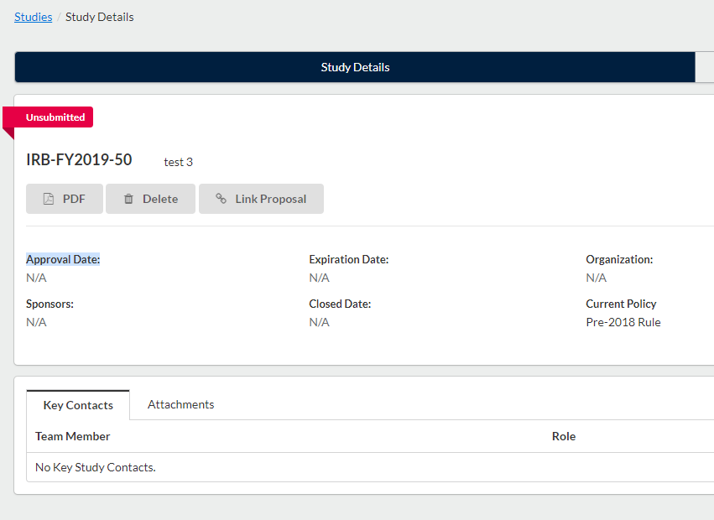
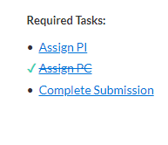
Getting started: Creating a new study
Your study status will be highlighted here.
Your Name
Study Title
1.
To access the full application, click on the “+ New Submission” button, and then select “Initial”.
Your study will be assigned a protocol number. This number will be used for the entire life of your protocol.
2.
Click on “Assign PI”, which will lead you to the full application.

Slide 32
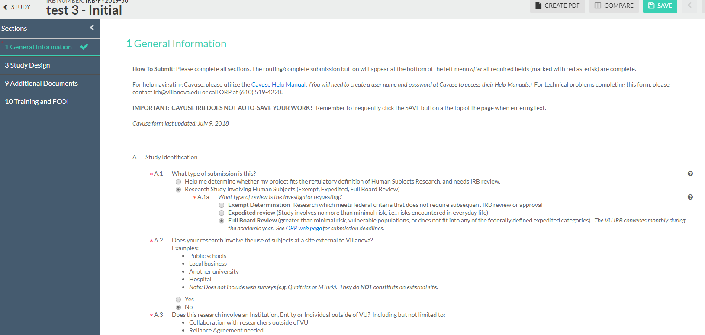
Getting started: Creating a new study
The interactive form will offer different questions depending on which answers you select.
Study Title - Initial
Optional: Use the menu on the left to navigate through your submission.
All personnel (including students) listed on your application must have completed all required CITI trainings and FCOI disclosure form. See irb.Villanova.edu for list.
Move your way through the form. You may save and return later if needed. You will need to include information about your study background and rationale, design, measures, etc.
Note: Cayuse does not auto-save!

Slide 33
Important notes
The initial submission appears below Study Details.
The person who creates the study is added as the Primary Contact by default. The PI needs to be assigned separately.
You can change the Primary Contact when editing the submission, if needed.
Click the Edit button to begin working on the initial submission.

Slide 34
More details
The Investigator Manual provides more information about submitting
Modification
Continuing Review
Closure
There is also a complete Cayuse User Guide with step-by-step guidelines and screenshots

Slide 35
Levels of risk and review categories
***delete number at left

Slide 36
IrB operations: more than minimal risk to human subjects/ full board review
Full Board Review
Research that is judged to involve more than minimal risk, or involves protected populations such as children, prisoners, disabled individuals or pregnant women (until Jan 2019), must undergo a full board review 45CFR46.103(b).
These protocols are reviewed at convened meeting of the IRB, once per month.

Slide 37
irB operations: minimal risk to human subjects/ expedited review
Expedited Review
Research that meets one of nine categories for inclusion as defined by the regulation and is found by reviewers to be no more than minimal risk.
OR can be used when reviewing an ‘active protocol’ for which the IRB conducted an initial review or a continuing review at a convened meeting or under an expedited review procedure during the preceding 12 months. (45CFR46.502)

Slide 38
IrB operations: low risk to human subjects/ exempt review
Exempt Review
A research activity may be declared exempt if it is considered low-risk and only involvement of human subjects will be in the categories outlined in 45CFR46.101 (b).
Risk is minimized through non-invasive procedures or anonymity in responses.
Eight categories for inclusion.

Slide 39
IRB Operations: Types of IRB review
Initial Review
The first review of a human subjects research protocol.
Modifications
An IRB shall review and have the authority to require modifications to secure approval. (45CFR46.109(a))
Annual or Continuing Review
An IRB shall conduct continuing review of research covered by this policy at intervals appropriate to the degree of risk, but not less than once per year, and shall have authority to observe or have a third party observe the consent process and the research. (45CFR46.109(e))
Incident
An occurrence of any protocol violation, noncompliance, deviation, or serious noncompliance that is not consistent with the approved study procedures.

Slide 40
IRB Operations: types of IRB review (cont’d)
Withdrawal
Any study that is no longer intended to be completed may be withdrawn from the system. Available for studies that have not been approved.
Closure
Any study where all study procedures have been performed and data collection/analysis is complete.
Administrator Closure
Similar to ‘closure’ but initiated and performed by IRB Administration staff.
Administrator Withdrawal
Similar to a ‘withdrawal’ but initiated and performed by IRB Administration staff.

Slide 41
IrB operations: Secondary Data
The use of secondary data is subject to IRB review if there are personal identifiers included in the data set.

Slide 42
irB operations: non-regulated human subject research studies
These types of activities are NOT subject to IRB oversight per regulations:
Journalism projects
Classroom projects
Program evaluations
Projects in which the focus is a business event
Departmental or University-wide studies
Biographies and case studies
Case studies: descriptions of clinical features or outcomes of three or fewer patients that do not contribute to generalizable knowledge

Slide 43
IRB Operations: Post Approval and Closure
After your study has been approved by the IRB, you will be responsible for submitting an annual review through Cayuse each year to update the IRB on your progress.
The structure of this review will vary depending on the level of review for your study.
Once research covered under your protocol has finished, close your study by completing a closure form through Cayuse.

Slide 44
Risks and benefits

Slide 45
Risk vs. benefits: a perfect balance
Minimize Risks
Maximize Benefits

Slide 46
Risks & benefits
Risk to the participants
The probability of harm (physical, psychological, social, legal, or economic) occurring as a result of participation in a research study. Both the probability and the magnitude of possible harm may vary from minimal to significant. The Federal regulations only define “minimal risk.” {AAHRPP.II.3.A}
Benefits for Humanity
A valued or desired outcome. Although these terms may appear straightforward, evaluations of risk and benefit are made more complex both by the subtle distinctions between therapeutic and research activities, and by evaluations of actual risks in the lives of normal and vulnerable classes of subjects (i.e., prisoners, children, cognitively impaired individuals, etc.)

Slide 47
Informed consent

Slide 48
Informed consent
Informed Consent is a requirement based on the ethical principles listed below:
Respect for Persons
Beneficence
Justice

Slide 49
Informed consent: what is it?
All research investigators who will involve human being as subjects, covered under 45CFR46.116, must obtain legally and prospectively effective informed consent from the subject or the subject’s legally authorized representative.

Slide 50
Informed consent: Cont’d
Prospectively refers to the continuous process throughout the conduct of research protocol.
Three key features of informed consent:
Disclose information to prospective subjects to make an informed decision.
Understanding what has been disclosed.
Promoting the voluntariness to whether or not to participate.

Slide 51
Informed consent: Basic elements
Involves Research
Foreseeable Risks
Benefits
Alternative Procedures
Confidentiality
Compensation for Injury
Contact in case of Injury
Voluntary Participation
Statement about use of deidentified data

Slide 52
Informed consent: an ongoing process
Consent
Adults (18 yo. and older)
Assent
Children (18 yo. and younger)
Waivers
Written documentation of consent
Alteration of Consent process

Slide 53
Vulnerable populations

Slide 54
Vulnerable populations definitions
Children:
Persons who have not attained the legal age for consent to treatments or procedures involved in the research, under applicable law of the jurisdiction in which the research will be conducted. Generally the law considers any person under 18 years old to be a child.

Slide 55
Vulnerable populations definitions
Veterans:
The Veterans Administration considers veterans to be potentially vulnerable populations because they have a history of obeying orders and making sacrifices, and may suffer from post-traumatic stress disorder or related disorders.

Slide 56
Vulnerable populations definitions
Prisoners:
Any individual involuntarily confined or detained in a penal institution. The term is intended to encompass individuals sentenced to such an institution under a criminal or civil statute, individuals detained in other facilities by virtue of statutes or commitment procedures which provide alternatives to criminal prosecution or incarceration in a penal institution, and individuals detained pending arraignment, trial, or sentencing.

Slide 57
Special considerations
Research done with vulnerable populations must be important to the vulnerable populations.
The research question must be unable to be answered by using a non-vulnerable population.
The risks vs. benefits must be appropriate to the vulnerable population.
Additional steps must be taken to minimize coercion, undue influence and exculpatory language.

Slide 58
Equitable selection of subjects

Slide 59
Equitable Selection: “fair” considerations
Fair
Benefits distributed fairly
No population is unfairly targeted
Just
Burdens distributed fairly
No population is unfairly excluded

Slide 60
Training

Slide 61
Be an informed researcher
Complete CITI training.
Continued education is important for understanding of how regulatory changes could impact your work.
Complete new investigator training.
Report all deviations to the IRB promptly.
Attend as many training sessions as you can.
Read the briefings from IRB Chair and ORP.

Slide 62
Website: IRB.Villanova.edu Email: IRB@Villanova.edu Emory Woodard Chair, IRB Email: emory.woodard@villanova.edu
CONTACT:

