Slide 1
Continuing Education Credits
Villanova University M. Louise Fitzpatrick College of Nursing is accredited as a provider of nursing continuing professional development by the American Nurses Credentialing Center’s Commission on Accreditation.
This webinar awards 1 contact hour for nurses

Slide 2
Conflict of Interest
The planners and presenter of this program have no conflicts of interest to disclose.
Accredited status does not imply endorsement by Villanova University, or the American Nurses Credentialing Center of any commercial products displayed or used in conjunction with this activity.

Slide 3
Continuing Education Certificate
To receive your CE certificate:
Look for an email containing a link to an evaluation. The email will be sent to the email address that you used to register for the webinar.
Complete the evaluation soon after receiving it.
It will expire after 3 weeks.
You will be emailed a certificate within 5 business days.

Slide 4
Suicide Prevention
International Perspectives

Slide 5
Goals
Recognize as a public health problem that can be addressed via PH means
Understand focuses of public health in suicide prevention and how they are applied in various contexts
Use knowledge from external suicide prevention programs to inform domestic policies and practice

Slide 6
Worldwide Causes of Death

Slide 10
Public Health and Suicide
What external and internal factors contribute to the decision to attempt suicide?
What methods do people use when they decide to end their life?

Slide 11
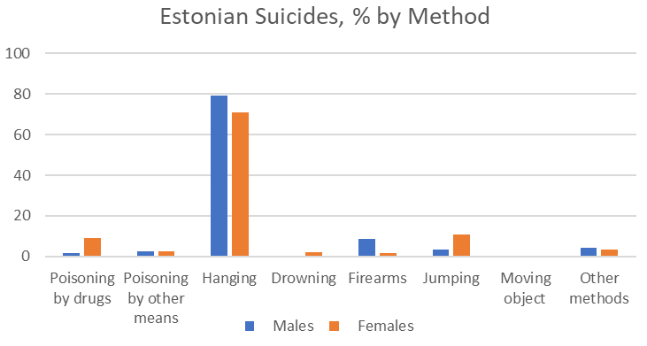
Suicide Shaped by Culture, Access

Slide 14
International Case Study
Sri Lanka

Slide 15
Sri Lanka
Island nation in the Indian Ocean
Population: ~ 22 million
Very long history
Discussed in the Ramayana in ~500 BCE

Slide 16
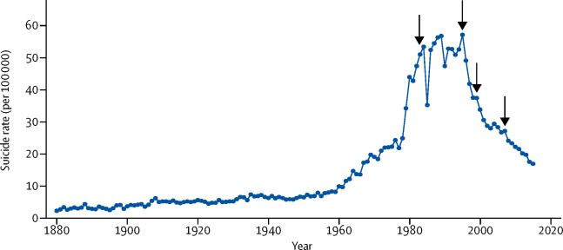
Sri Lanka Suicide Rates

Slide 17
Sri Lanka Suicide Rates
Industrialization and Civil War

Slide 18
Industrial Agriculture
Sri Lanka transitioned from an agrarian/maritime society to an industrial agriculture society fairly quickly
Without license, training, or environmental standards on storage, lethal and toxic chemicals common and available
Different ones have different fatality rates for ingestion

Slide 19
Sri Lanka Suicide Rates
First Insecticide Ban

Slide 20
Sri Lanka Suicide Rates
All Class 1 Pesticides Banned

Slide 21
Sri Lanka Suicide Rates
All Class 1 Pesticides Banned

Slide 22
Sri Lanka Suicide Rates
Cease Fire

Slide 23
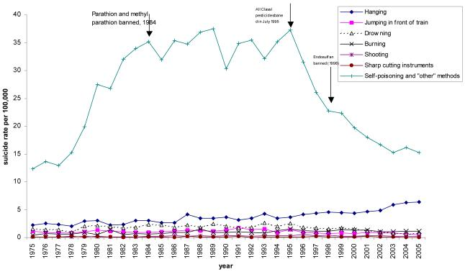
Rebound Effect

Slide 24
Success? Yes and No

Slide 25
International Case Study
Sweden

Slide 26
Warning: This Example is Older
But still relevant!

Slide 27
Sweden (and Gotland)
Northern European Country
Population ~10.5 million
Expansive public health system
Gotland is a large island and province

Slide 28
Suicide in Sweden
In the 1970s, Sweden had a substantially higher suicide rate than its neighbor Norway, comparable to the US
Sweden adopted a national suicide prevention program in the 1980s and tested various approaches
Gotland was evaluated in a program to train primary care providers to recognize, respond to, and treat depression (pharmacologically)

Slide 29
Effect of Training on Suicides

Slide 30
Medication Prescriptions

Slide 31
Inpatient Psychiatric Care

Slide 32
Success? Yes (But also Maybe)
Notes:
PROSPECT trial showed great results, as did hungary’s creation of a telephone psychiatry consultation service, but those were both examined at the participant level, so we don’t know about the greater impact

Slide 33
Implications for Policy and Practice

Slide 34
Policy
Multi-pronged approaches critical to prevent suicides
Educational
Develop a healthcare workforce that can address suicide risk
Recognize warning signs and know methods
Treat and respond before crisis
Avoid practices that are associated with increased risk of death
Integrate training into all relevant disciplines
Access
Make gun locks/safes free, cheap, or subsidized
Identify other ways that people die by suicide and work on safety
Automobiles
Police
Treatment
Focus on developing and implementing highly accessible treatments

Slide 35
Nursing Practice
RN
Recognize warning signs of suicide
Discuss concerns both with patients and other providers
Work on connectivity to care and establishing policies using best practices
Advanced Practice
AP nurses who work in primary care, emergency, etc. should receive training and support in suicide prevention practices
Increase workforce that focuses on mental health and suicide prevention
Nursing Research
Collaboration between environmental health and suicide prevention programs in certain communities
Few nurses know about chemicals (household or agricultural)
All: Recognize the culturally embedded and multifactorial nature of suicide

Slide 36
Questions?

