Slide 1
Villanova University
Transforming the Campus Landscape
Town Hall Meeting

Slide 2
Transforming the Campus Landscape
Goals
Impact to Faculty & Staff
Detailed plans
Schedule
Communication plan to community
Town Hall Meeting
March 2011
Notes:
Goals: Safety, transform the ped core (aesthetics), create & improve outdoor living spaces
Impact: no through traffic-use Fedigan gate
additional parking in front of TOL (pls respect grounds)
moveable bollards
Schedule: Bd approved 22.5M, Start May 16th, Phases 1-3

Slide 3
Transforming the Campus Landscape
Goals
Safety – vehicle free
Pedestrian friendly
More accessible
Aesthetically beautiful
Create & improve outdoor living spaces
Impact to Faculty & Staff
Detailed plans
Schedule
Communication plan to community
Town Hall Meeting March 2011
Notes:
Goals:create a campus core that is vehicle-free, more pedestrian-friendly, more accessible to people with different mobility needs, and more aesthetically beautiful
Impact: no through traffic-use Fedigan gate
additional parking in front of TOL (pls respect grounds)
moveable bollards
Schedule: Bd approved 22.5M, Start May 16th, Phases 1-3

Slide 4
Transforming the Campus Landscape
Goals
Impact to Faculty & Staff
No through traffic
Villanova service vehicle access to core
Use Fedigan gate
Additional parking in front of Tolentine
Moveable bollards
Detailed plans
Schedule
Communication plan to community
Town Hall Meeting March 2011
Notes:
Goals: Safety, transform the ped core (aesthetics), create & improve outdoor living spaces
Impact: no through traffic-use Fedigan gate
additional parking in front of TOL (pls respect grounds)
moveable bollards
Schedule: Bd approved 22.5M, Start May 16th, Phases 1-3

Slide 5
Transforming the Campus Landscape
Goals
Impact to Faculty & Staff
Detailed plans
Schedule
Communication plan to community
Town Hall Meeting March 2011
Notes:
Goals: Safety, transform the ped core (aesthetics), create & improve outdoor living spaces
Impact: no through traffic-use Fedigan gate
additional parking in front of TOL (pls respect grounds)
moveable bollards
Schedule: Bd approved 22.5M, Start May 16th, Phases 1-3

Slide 8
Moveable Bollards

Slide 9
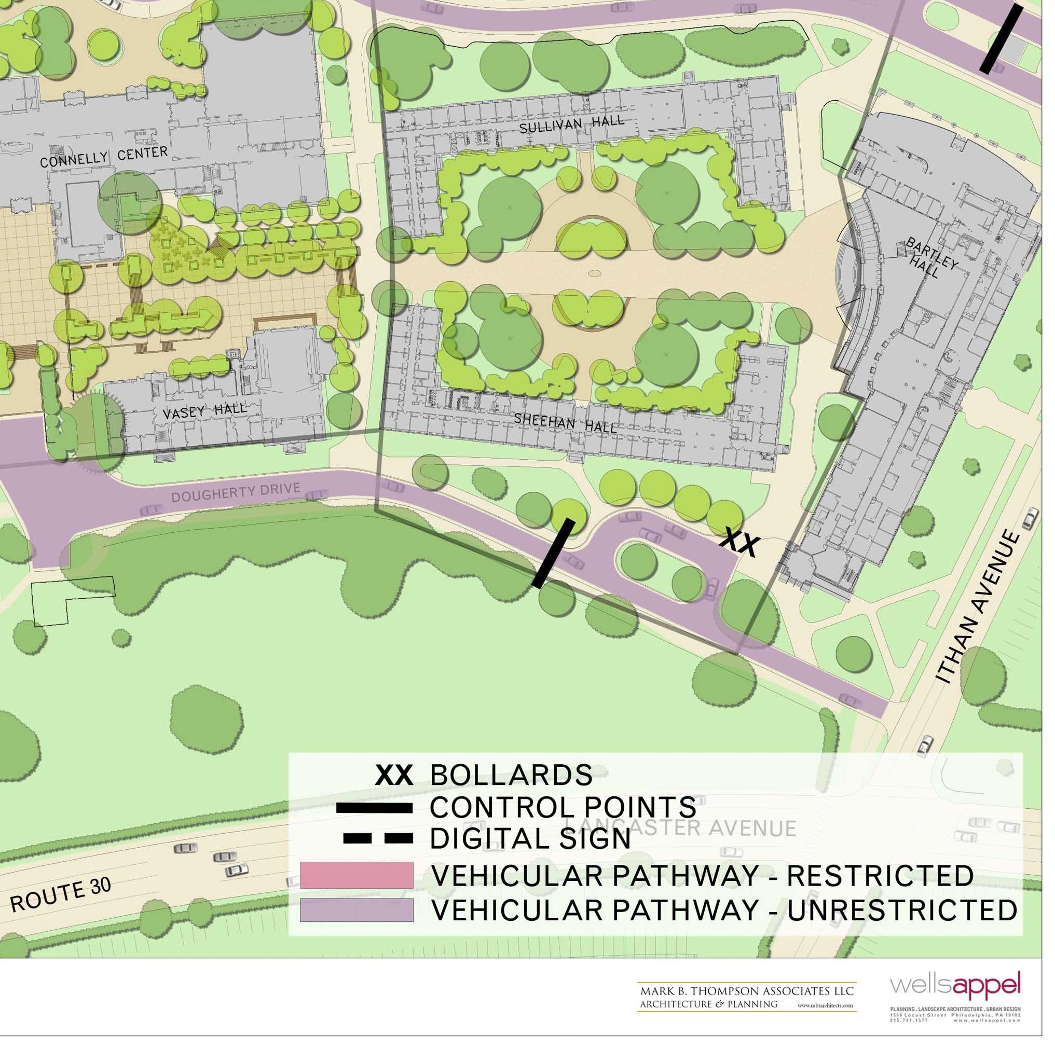
Sheehan-Sullivan Quad
Adequate pedestrian walkway from Bartley to Oreo
Seating areas offset from walkway
Segregated shaded gathering areas in both building courtyards.
Handicap access from Dougherty Dr. at Bartley & Vasey ends of Sheehan Hall
Improved pathways from Driscoll Hall to main campus

Slide 10
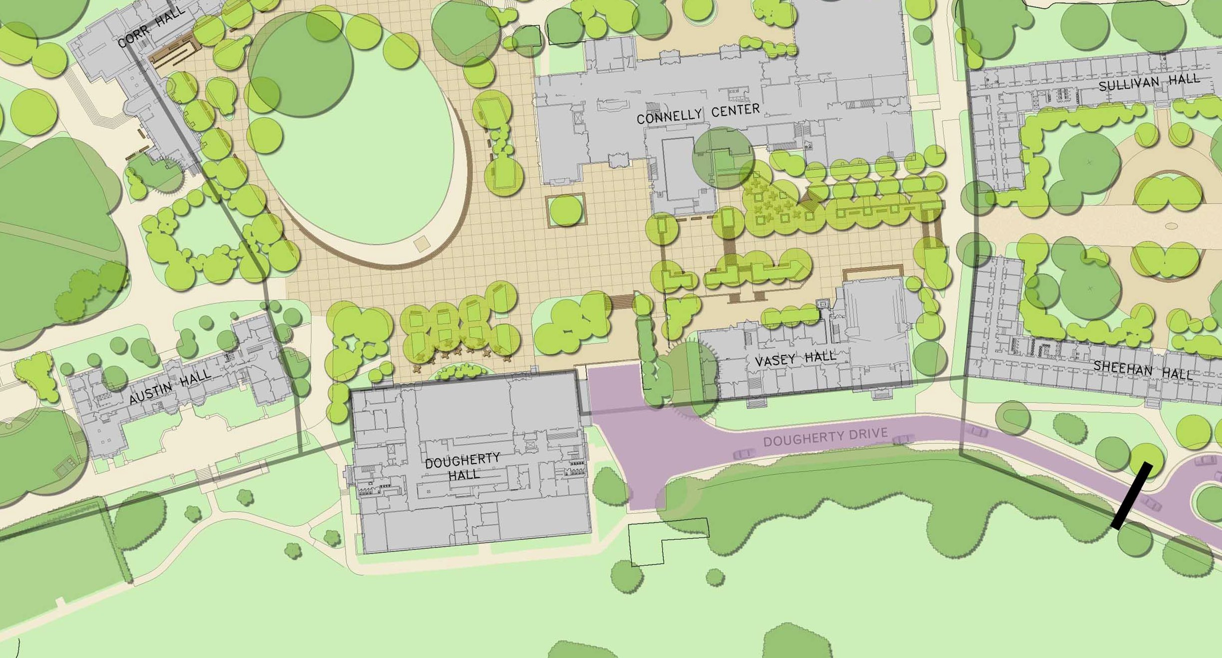
Vasey Plaza - Oreo
Two levels of gathering space: plazas widened to allow ramps on both sides
Stairs flanked by ramps will rise approximately six feet per tier
Mid-level plaza will provide access into Belle Air Terrace with outdoor cafe
Convenient access to Vasey from all levels

Slide 11
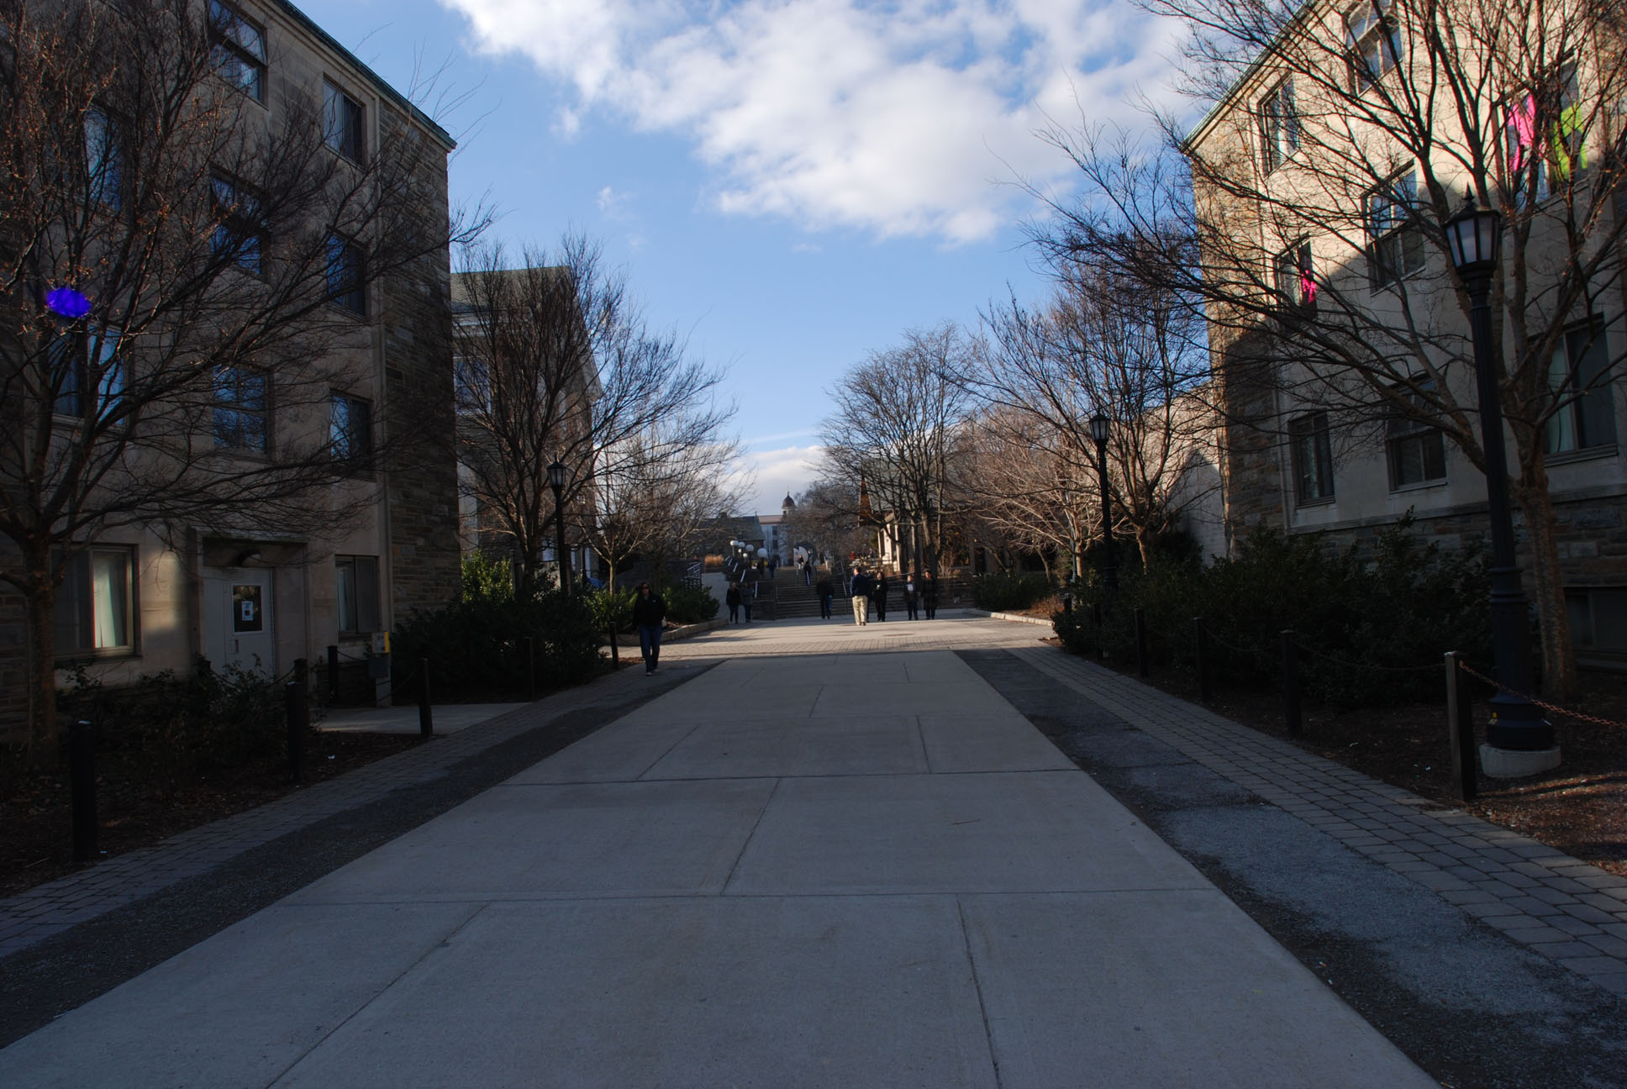

Slide 12
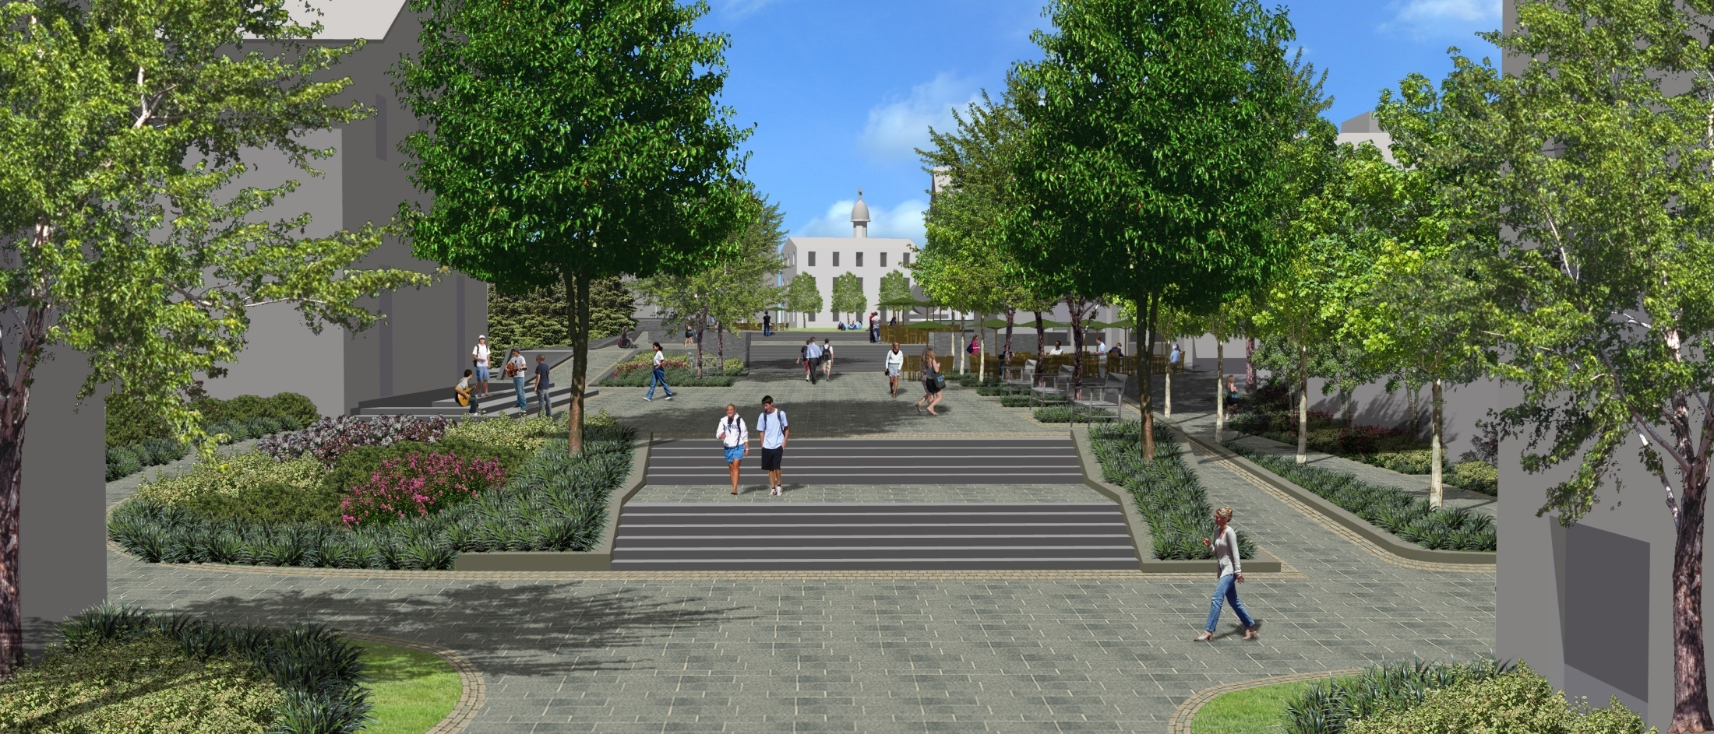

Slide 13
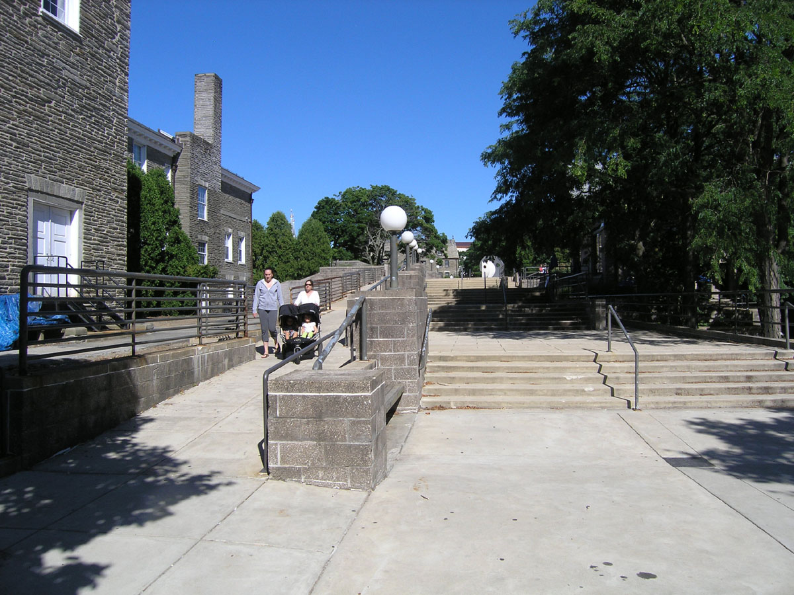

Slide 17
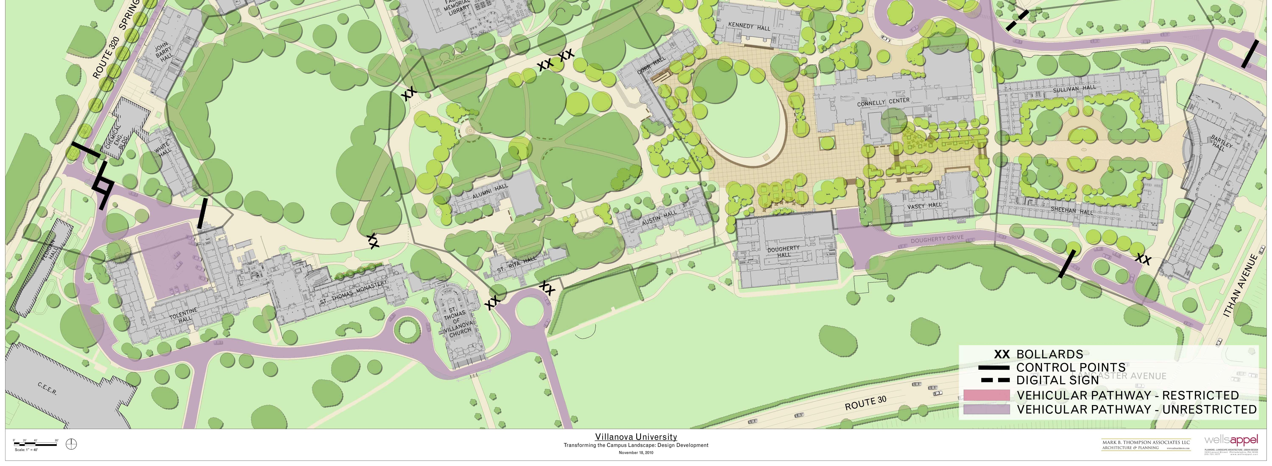
Expanded Oreo
Ravine between existing Oreo and Dougherty will be leveled to greatly expand gathering space
Potential for glass-walled terrace in front of Dougherty for open/closed café
Storage space for tables and other student activity needs. Integral power & communications for events
Kennedy ‘wagon wheel’ converted to open oval ‘green’, with tiered seating/stairs at one end.
High canopy trees will draw Corr’s majestic façade into space but provide some shade
Defines the Oreo while providing two different functional spaces that are visually connected

Slide 18
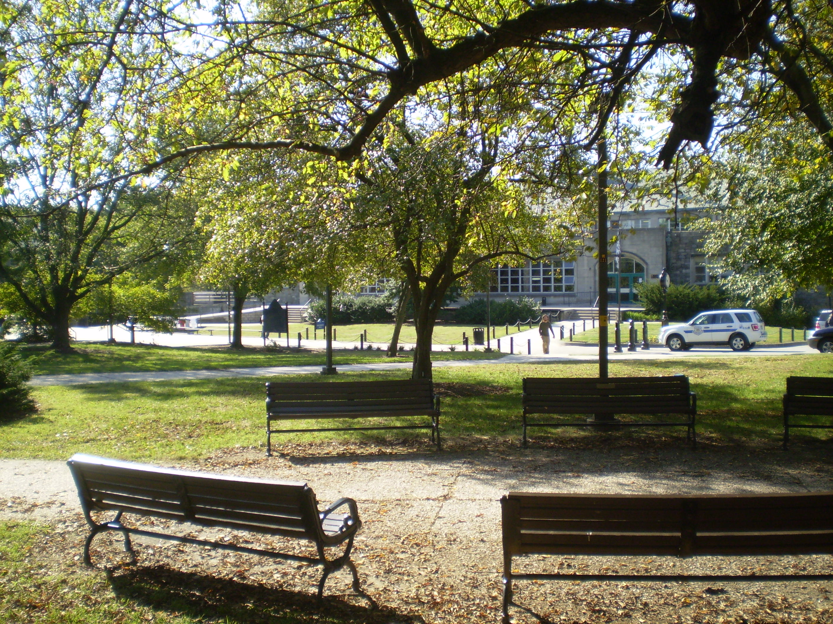

Slide 19
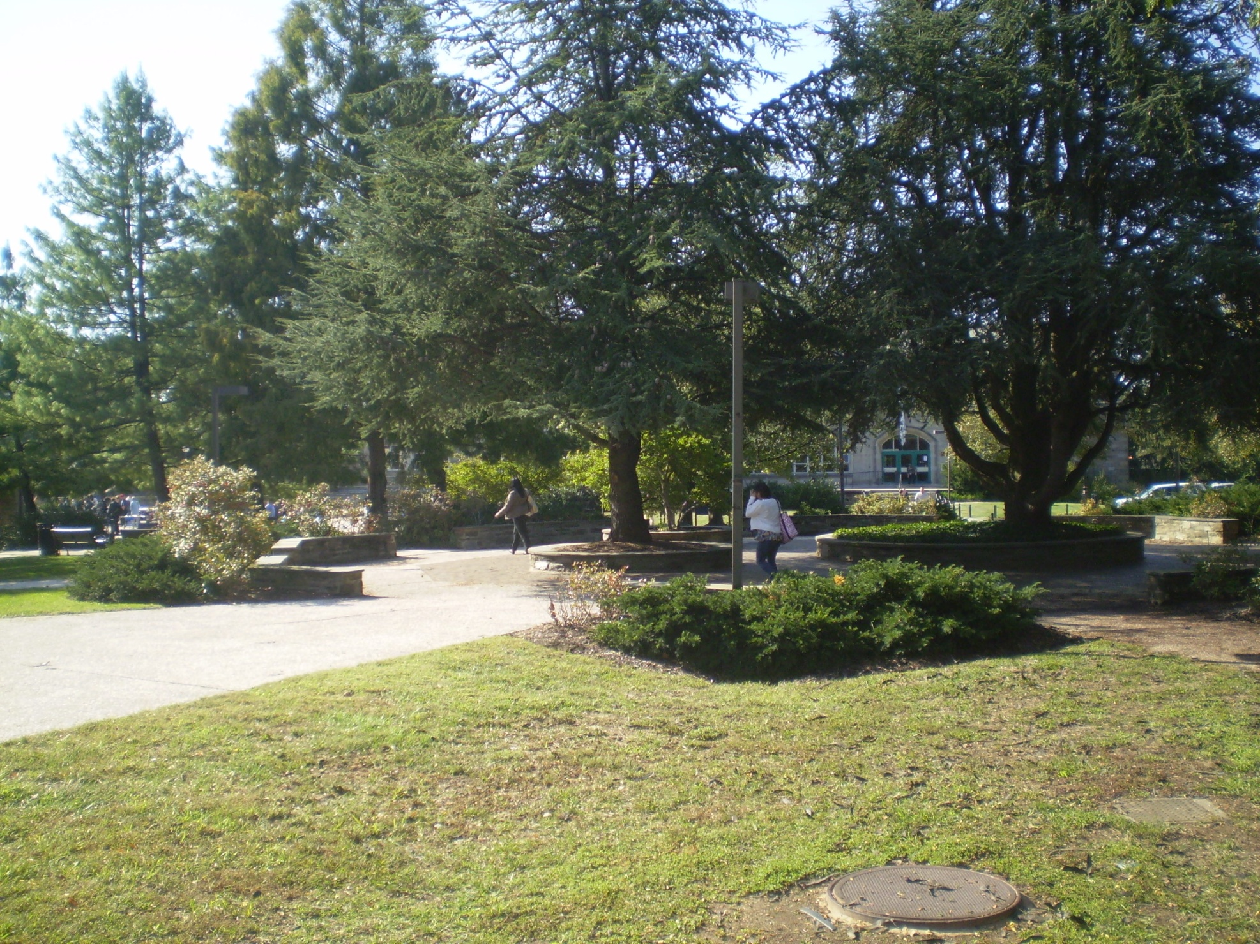

Slide 20
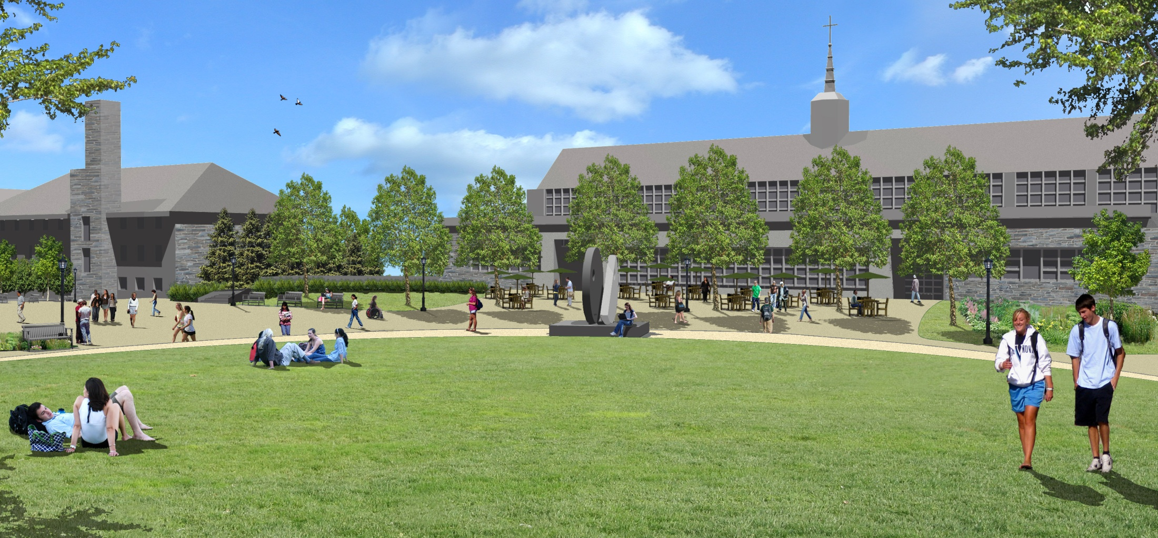

Slide 22
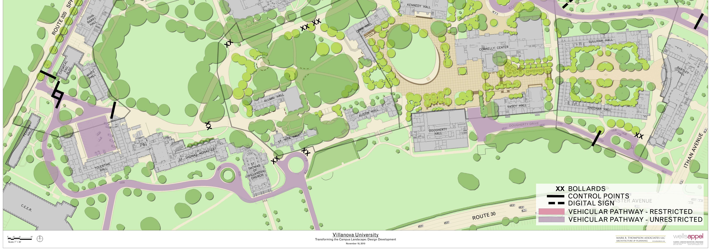
Grotto – Limit vehicular traffic
Move low-growth vegetation to front of Alumni Hall
Allow clear sight lines toward new promenade in front of Corr’s Arch
Simplified pathways
Create [formal] garden central to Alumni Hall’s entrance, with statue/art or fountain
Smooth out and widen curves of pathway between Falvey & west side of Alumni
Relocate statue of St Augustine to provide more visibility
Improve student passageway between St Rita/Alumni past Monastery to Tolentine
Smaller, more intimate grotto located between Austin & St Rita Halls

Slide 23
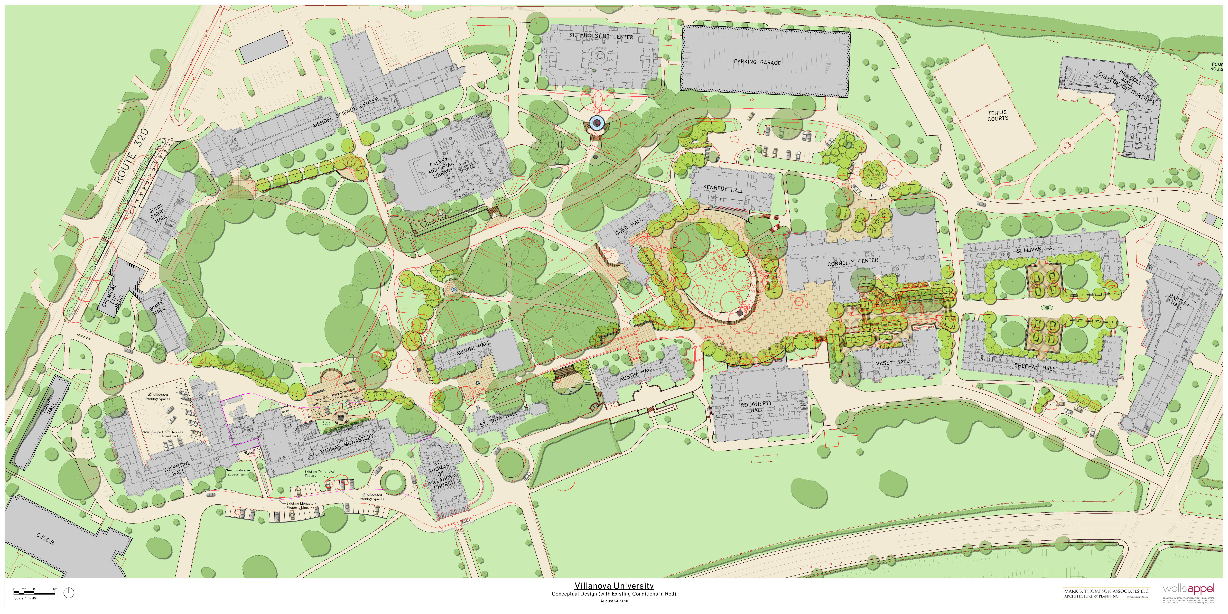
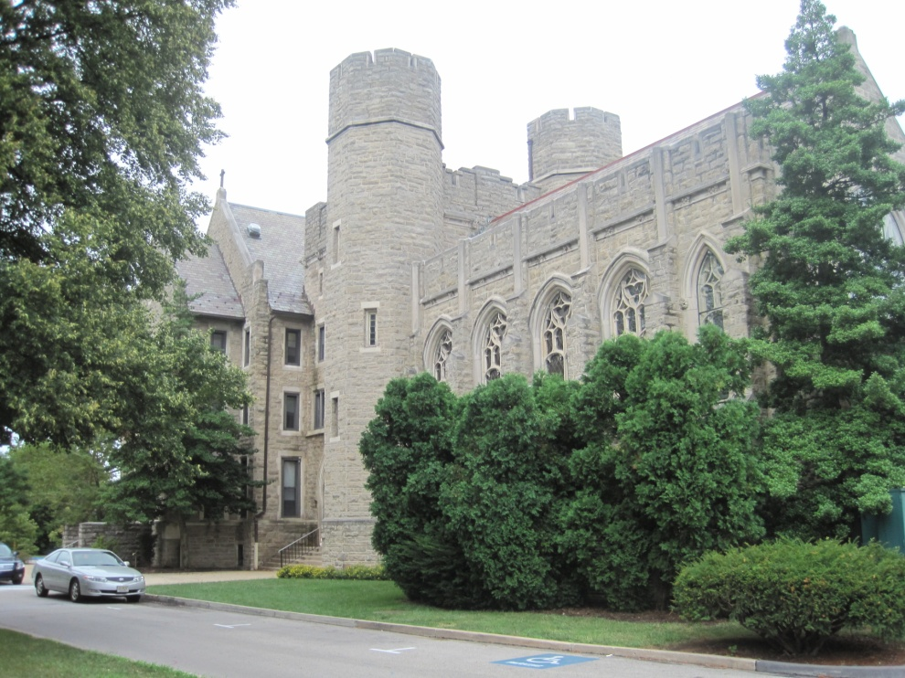

Slide 24
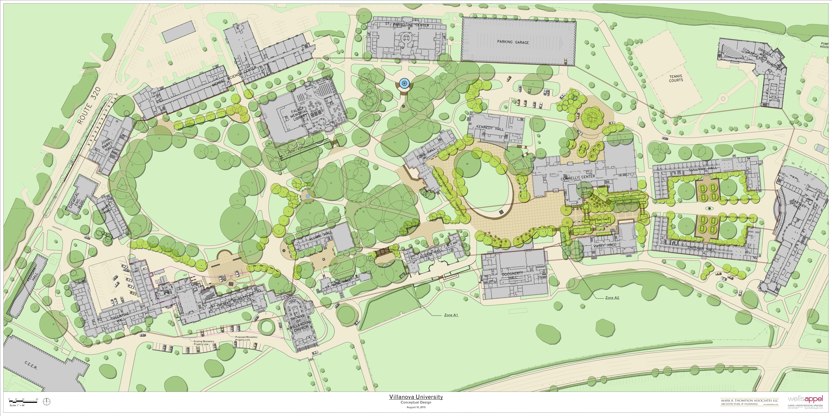
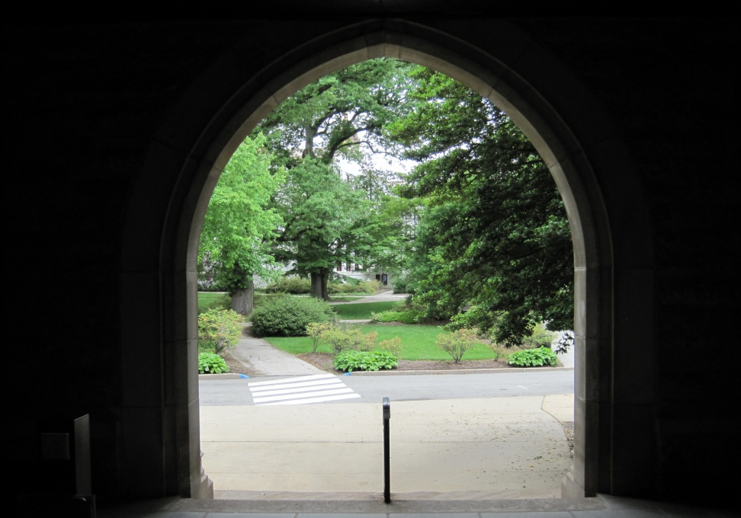
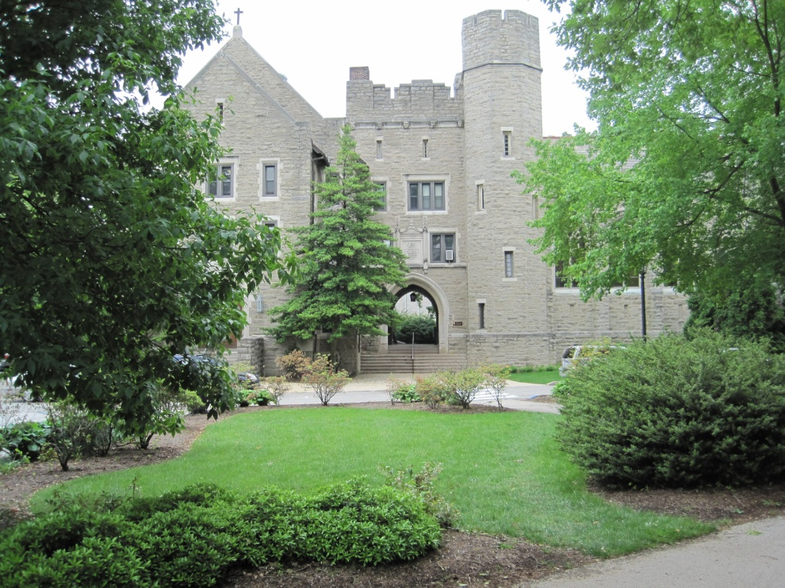
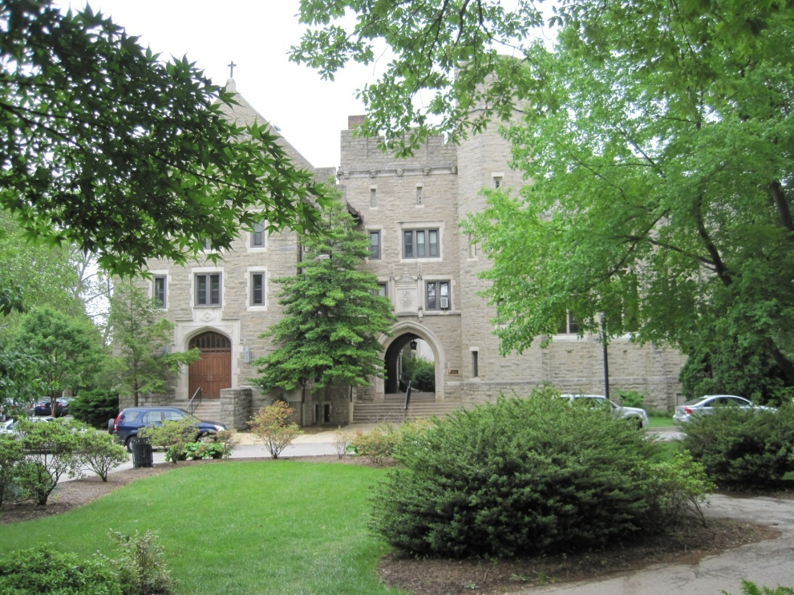

Slide 25
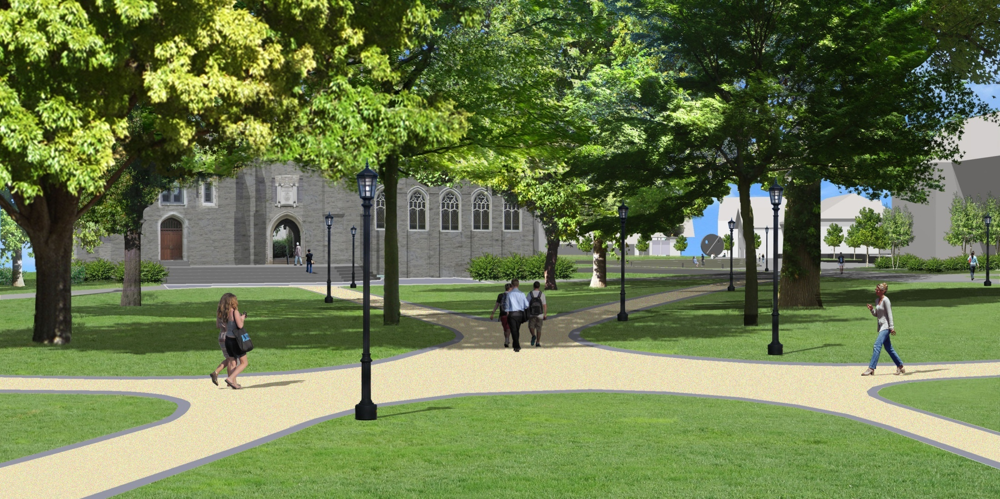

Slide 26
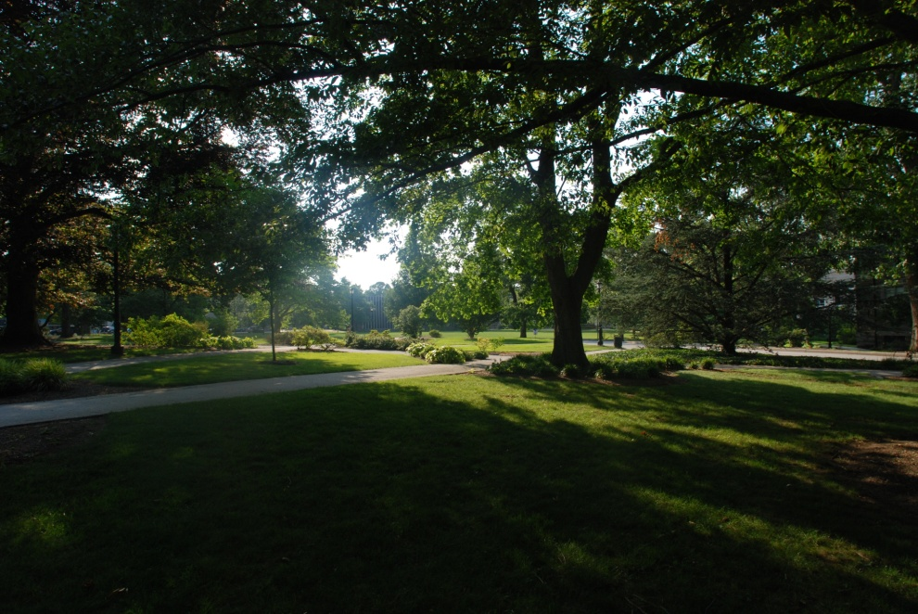
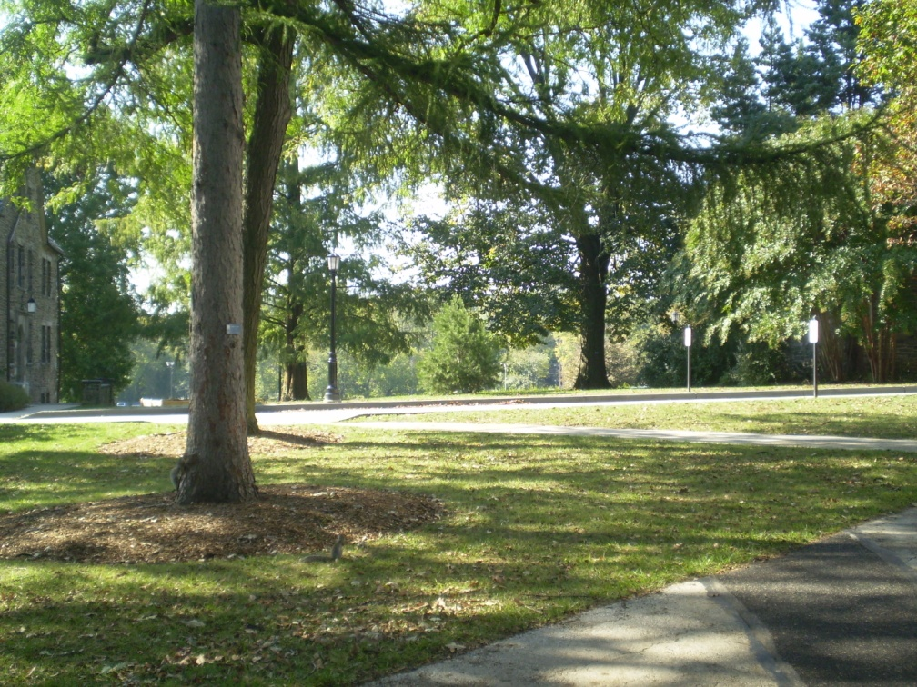
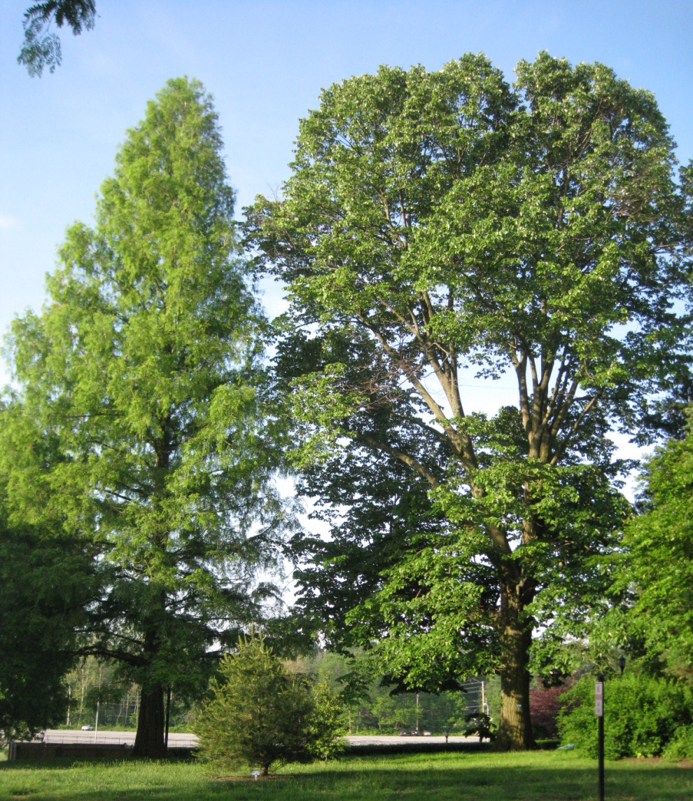

Slide 27
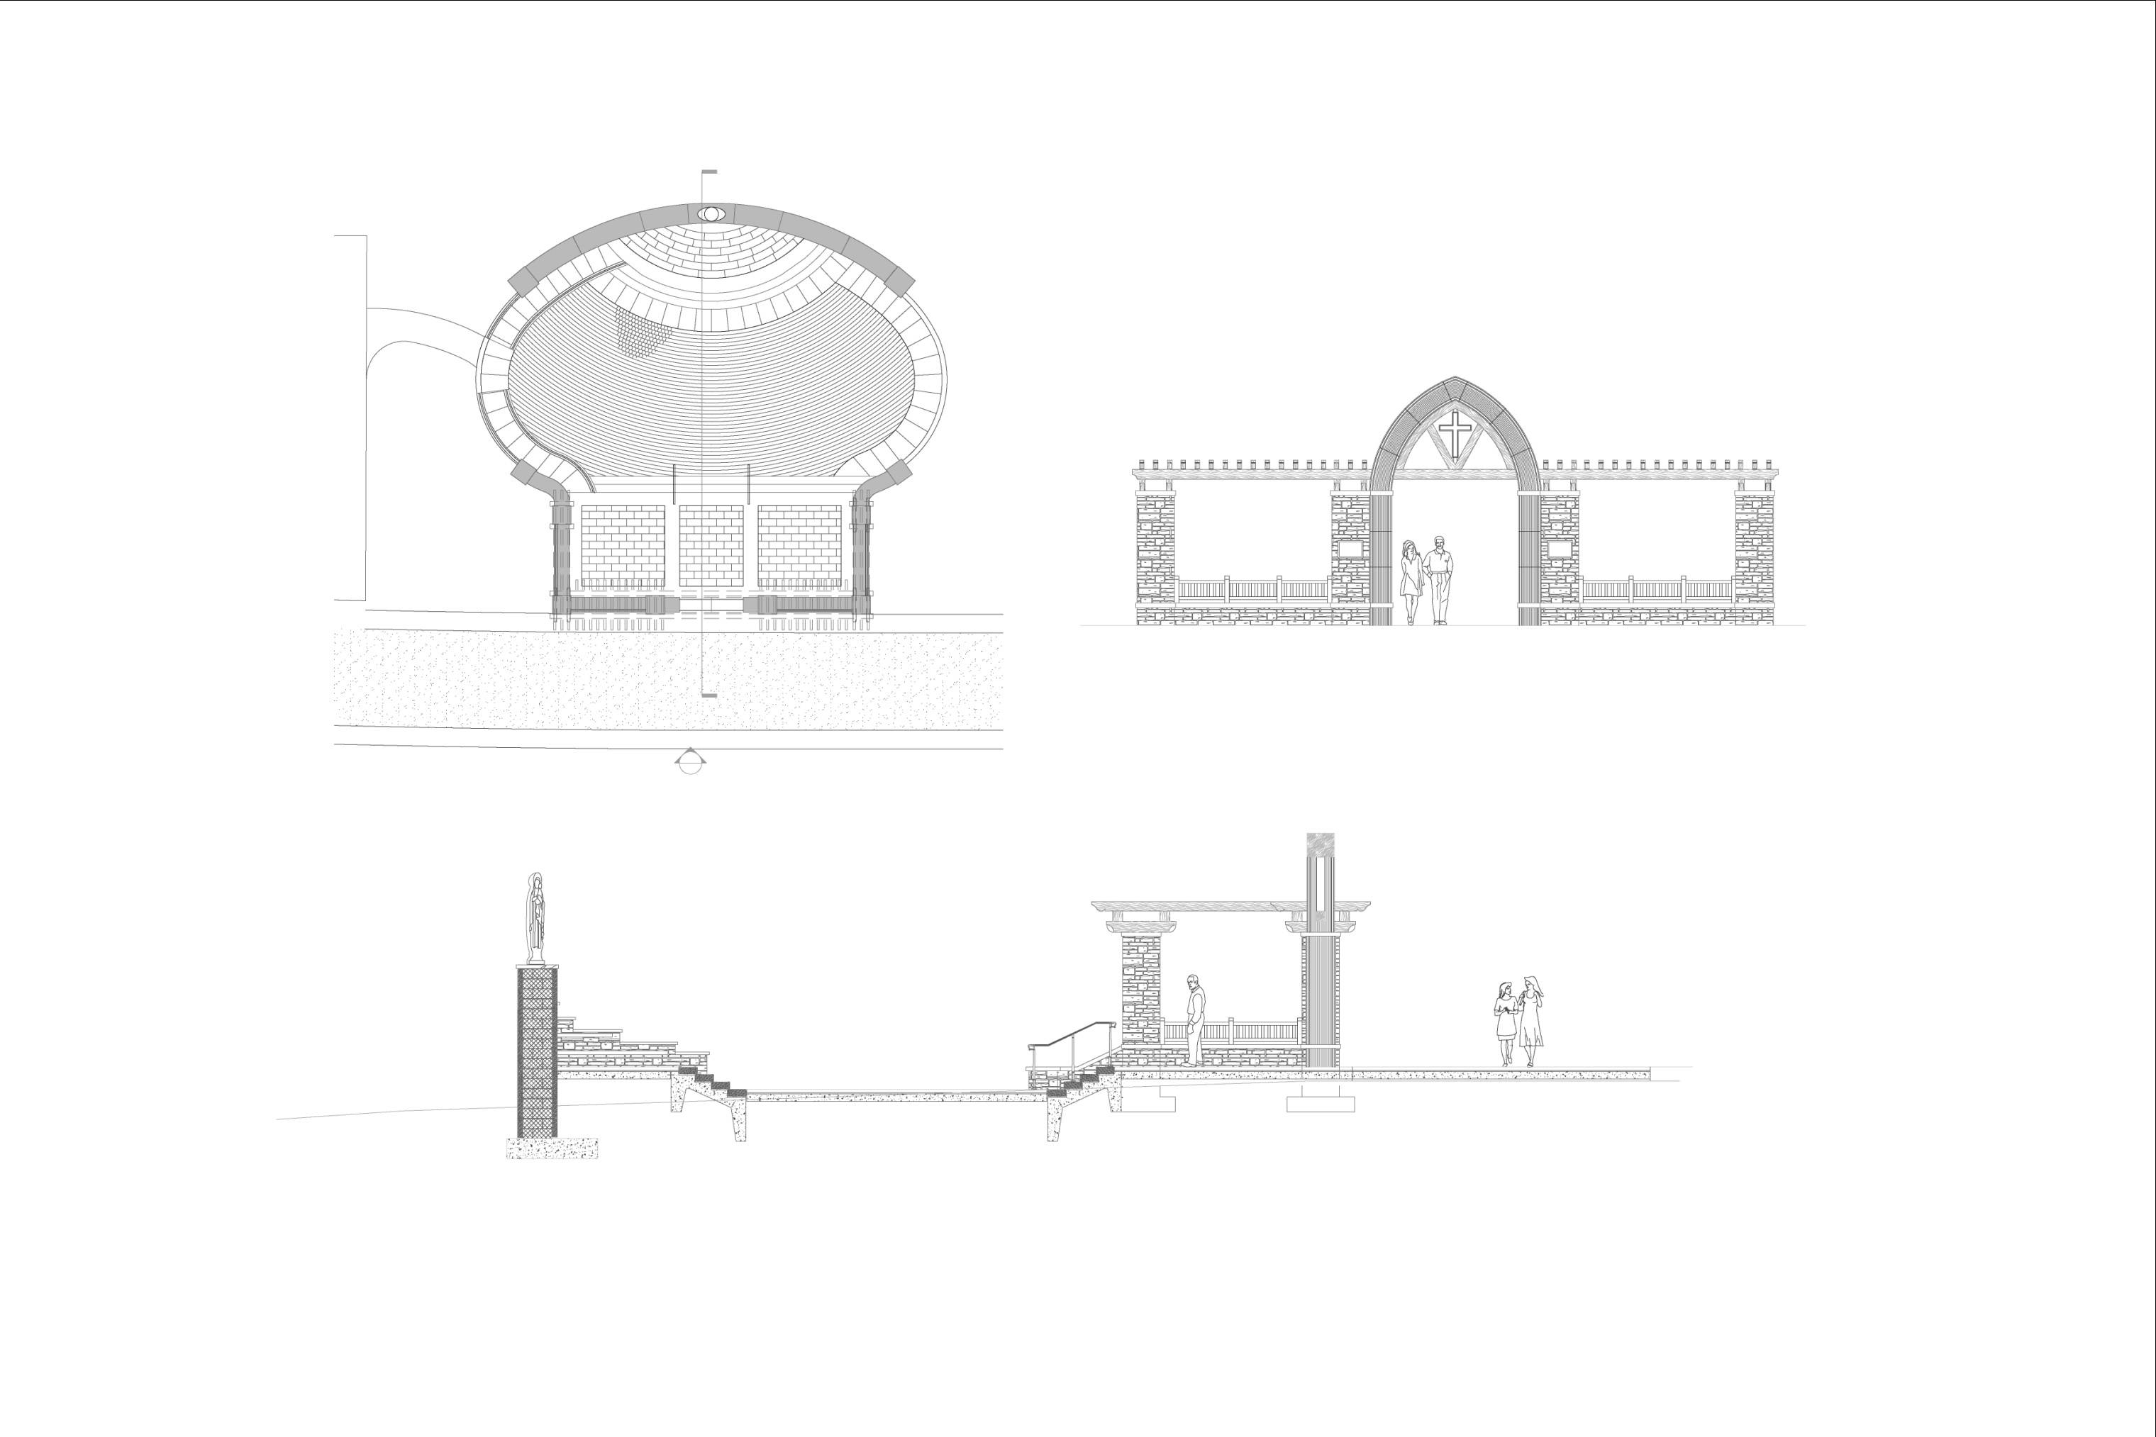

Slide 28
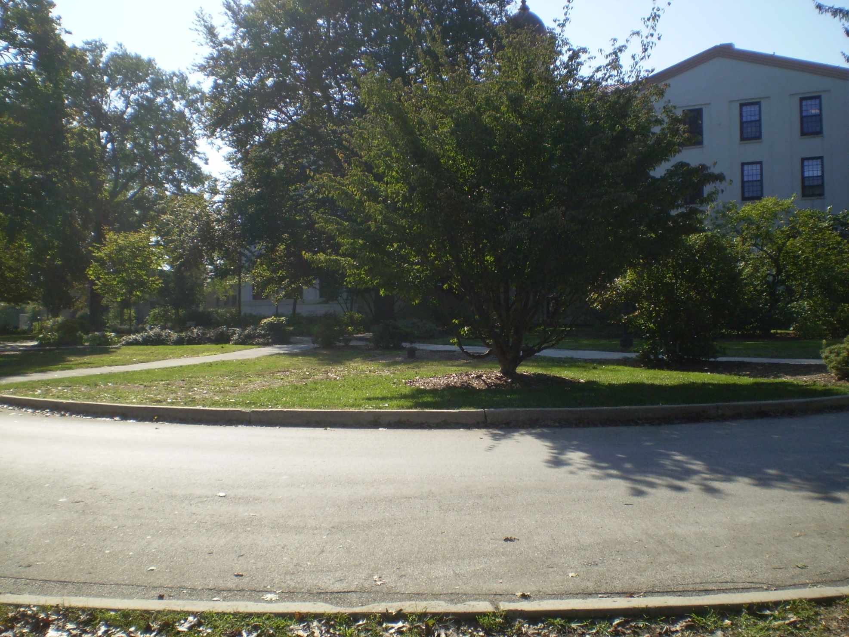

Slide 29
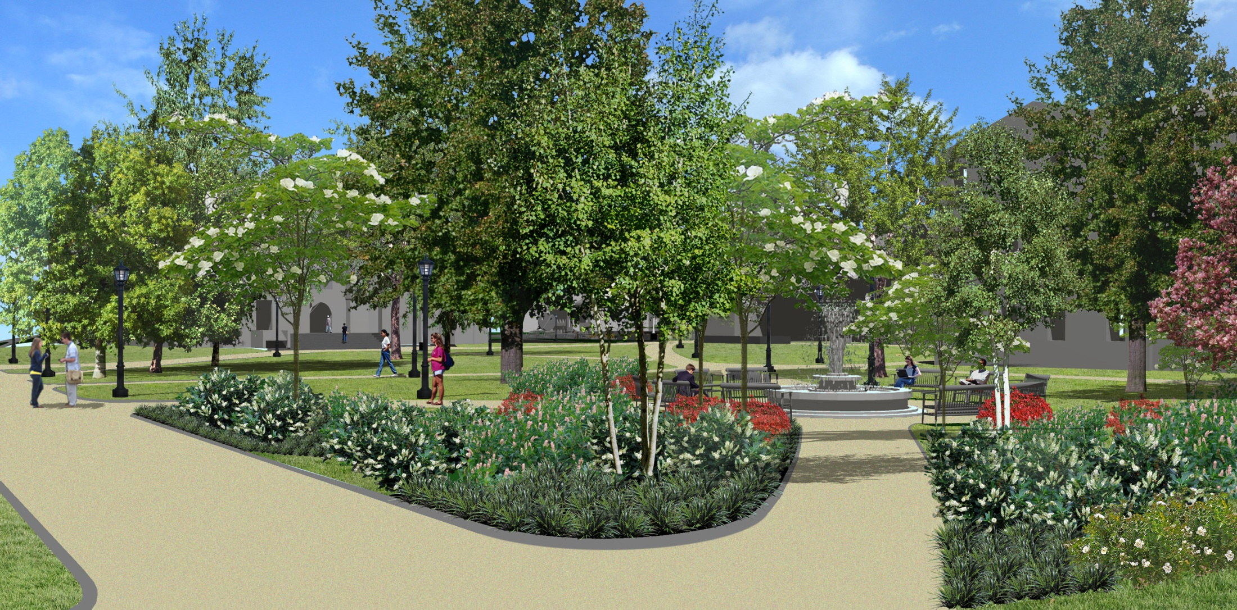

Slide 33
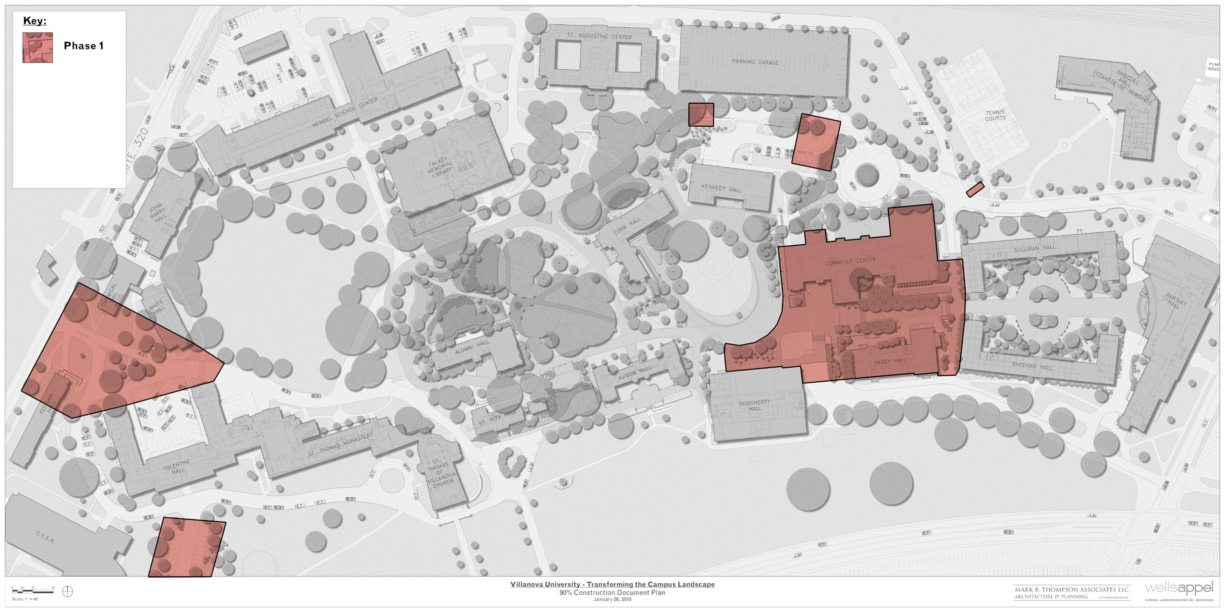
Phase 1: Mid May – November 2011
Town Hall Meeting March 2011
Notes:
Trying to be parking and storm water neutral!
Fr. Peter asked to move Dougherty-Kennedy ellipse into Phase I, we’re investigating.

Slide 34
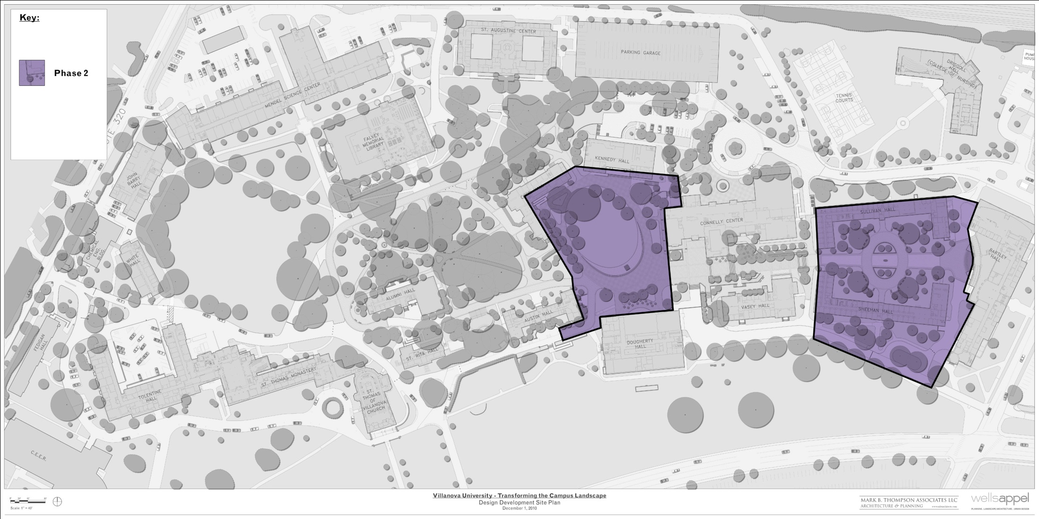
Phase 2: Mid May – October 2012
Town Hall Meeting March 2011

Slide 35
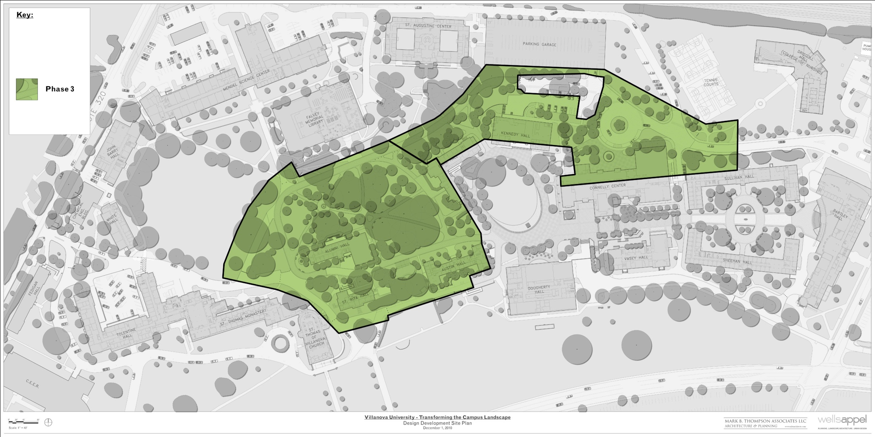
Phase 3: Mid May – October 2013
Town Hall Meeting March 2011

Slide 36
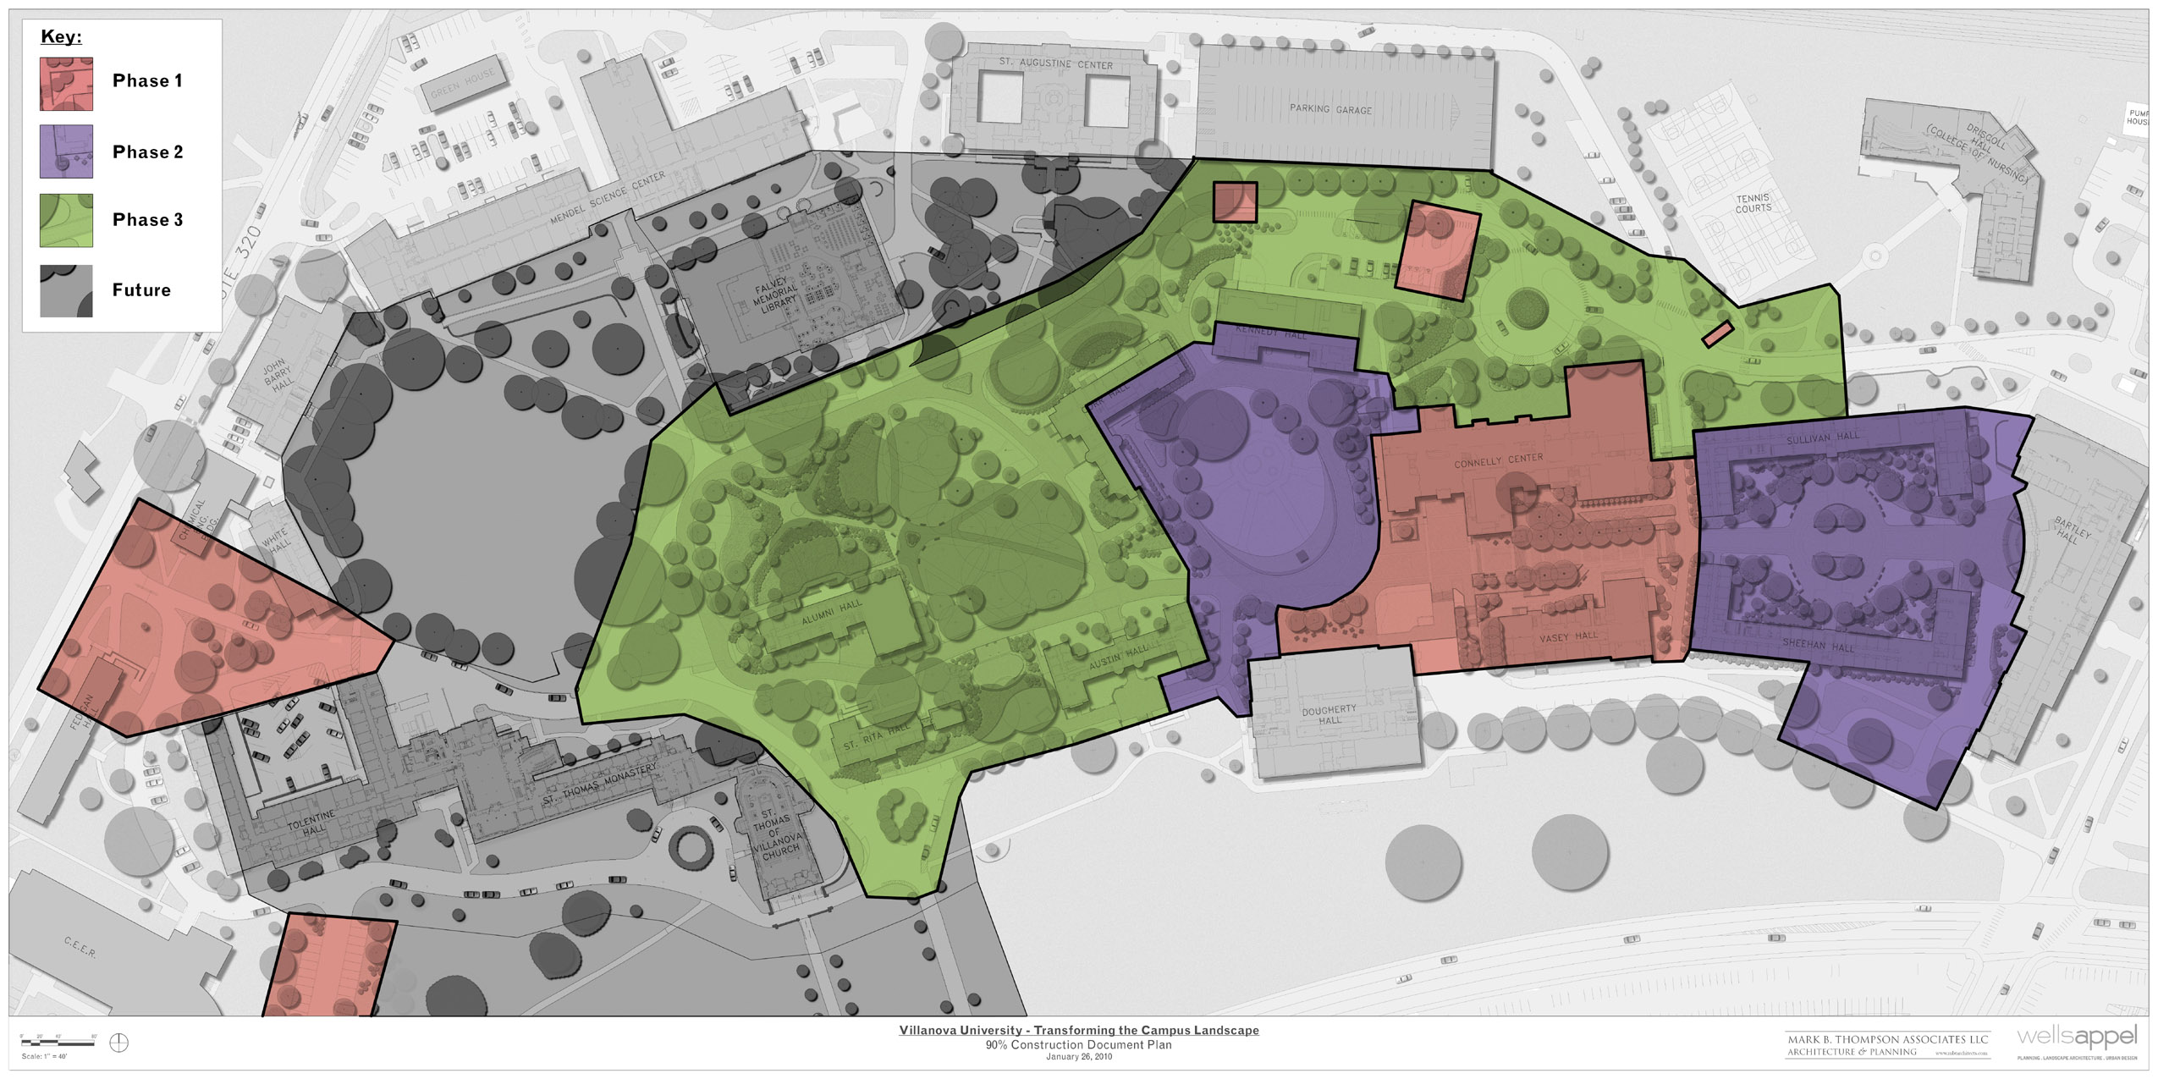
All Phases
Town Hall Meeting
March 2011

Slide 37
Church Access

Slide 38
Transforming the Campus Landscape
Goals
Impact to Faculty & Staff
Detailed plans
Schedule
Communication plan to community
Town Hall Meeting March 2011
Notes:
Goals: Safety, transform the ped core (aesthetics), create & improve outdoor living spaces
Impact: no through traffic-use Fedigan gate
additional parking in front of TOL (pls respect grounds)
moveable bollards
Schedule: Bd approved 22.5M, Start May 16th, Phases 1-3

Slide 39
Communication Plan
Group | Plan
Board of Trustees | Board meeting updates
President’s Cabinet | Cabinet meeting updates
Augustinian Order | Meetings
St. Thomas of Villanova Parish | Meetings
Students, Faculty, Staff | Town Hall meetings Print brochures, Fr Peter Ltr Article in Villanovan Web page content
Vendors, Delivery providers | Letter from Procurement
Alumni | Article in Villanova Magazine Nova Notes
Neighbors | Neighbors Update
All, public | Web site
Town Hall Meeting March 2011

Slide 40
Villanova University
Transforming the Campus Landscape

